Slide 1
2024 YOUR COMPANY HERE
Championship
Presented by YOUR COMPANY HERE
September 6-8, 2024
Gadsden Shooting Center Iberia, Missouri

Slide 2
2024 YOUR COMPANY HERE Generation III Gun Championship Presented by Your COMPANY HERE
Mission Statement
Generation III Gun Inc. is an exciting nonprofit 501(c)(3) organization focused on promoting the competitive shooting sports to juniors. Junior shooters are the future of the 2nd Amendment. We will strive to educate juniors about the important role that they will play in the future of firearms in this country through the enjoyment and camaraderie of competitive shooting sports. We aim to become the organization that ensures that every junior shooter that wants to attend a 3 gun match can. Our goal is to reimburse junior shooters for every major 3 gun match entry fee. Once that goal is accomplished, we will focus on our ultimate goal of ensuring that any junior that wants to shoot a major match has the resources they need to do so.

Slide 3
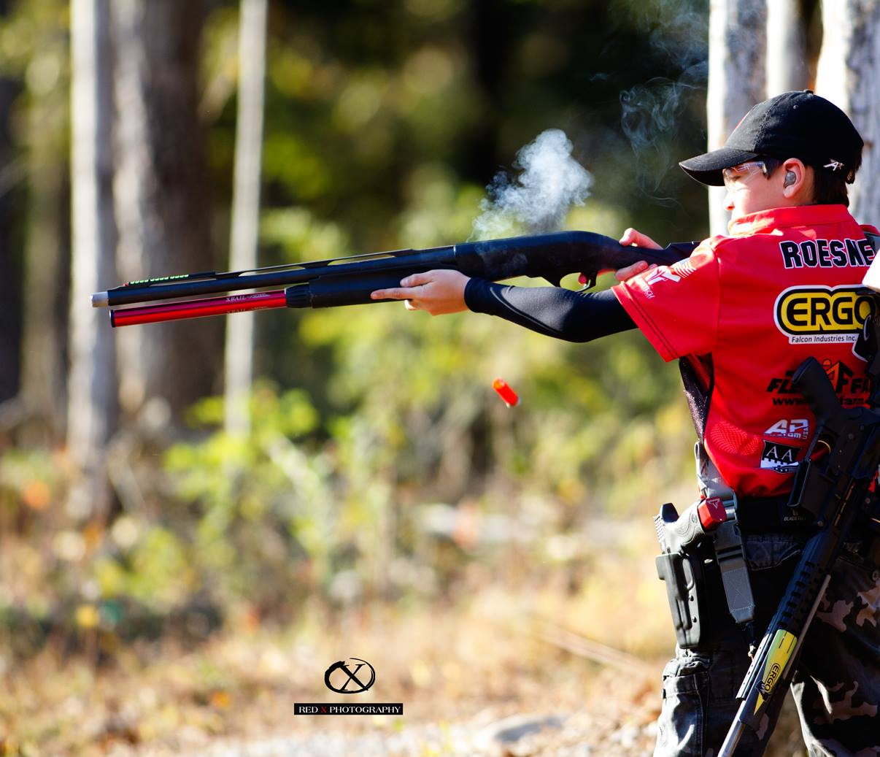
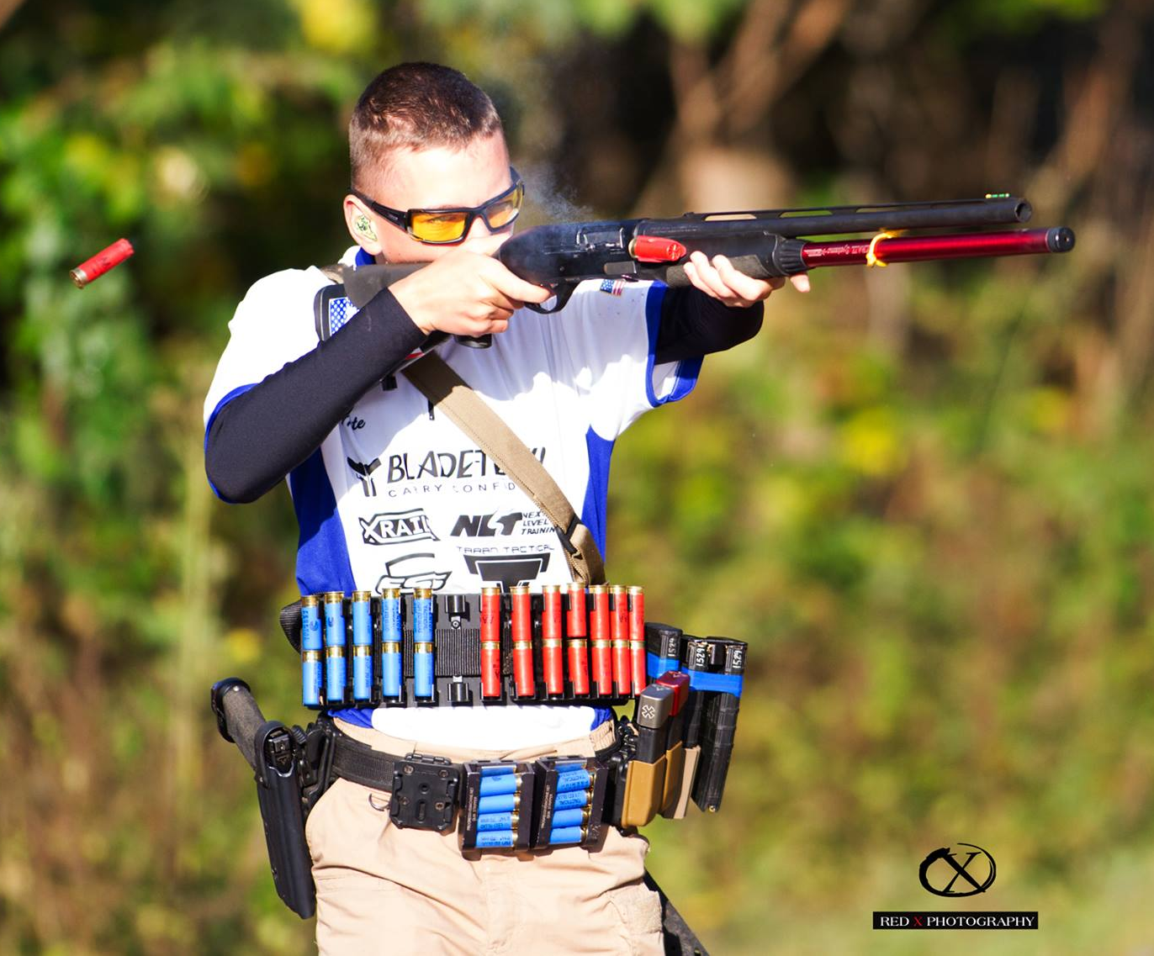
Generation III Gun Championship
The 2024 Generation III Gun Championship, will be held on September 6-8. The range is located 25 miles from downtown Osage Beach in the heart of beautiful Lake of the Ozarks Missouri.
250 competitors from around the country will compete in 8 challenging courses of fire shot over 3 days.
Competitors will receive prizes for individual finishes and be given the opportunity to “walk the prize table” and see your product donations at the awards ceremony.
your products will be on display on the match website, Facebook, Instagram, and various internet firearms forums.

Slide 4
Generation III Gun Championship
ENDOWMENT SPONSOR
$50,000 cash donation
Primary Banner placed on the Generation III Gun Website
Special mention in all generation III gun profiles on social media outlets
named annually at the championship as the organization’s endowment sponsor
Company banners will be placed at the Range Entrance, awards ceremony, and key locations on the stages during the match where they will be captured on every match video
Special Mention during opening and closing ceremonies and Shooters Meeting
Mentioned and thanked during each stage briefing in front of every competitor in attendance
Logo appears on trophies presented to the top three shooters in each division and top ten junior shooters
Access to a vendor table at match and/or awards ceremony
Extra emphasis given during all media coverage
Largest logo on match t-shirt
Three shooter slots in the match annually
Priority squadding for shooter slots

Slide 5
Generation III Gun Championship
TITLE SPONSOR
$20,000 cash, retail value prizes, targets or range/match materials
named as the title sponsor for the match
2024 TITLE SPONSOR Generation III Gun Championship Presented By Presenting Sponsor
Company banners will be placed at the Range Entrance, awards ceremony, and key locations on the stages during the match where they will be captured on every match video
Special Mention during opening and closing ceremonies and Shooters Meeting
Mentioned and thanked during each stage briefing in front of every competitor in attendance
Logo appears on trophies presented to the top three shooters in each division and top ten junior shooters
Access to a vendor table at match and/or awards ceremony
Donated products featured on GIIIG website, Facebook and other social media outlets
Extra emphasis given during all media coverage
Primary logo on match t-shirt
Three shooter slots in the match
Priority squadding for shooter slots

Slide 6
Generation III Gun Championship
Presenting SPONSOR
$15,000 cash, retail value prizes, targets or range/match materials
named as the presenting sponsor for the match
2024 TITLE SPONSOR Generation III Gun Championship Presented By Presenting Sponsor
Company banners will be placed at the Range Entrance, awards ceremony, and key locations on the stages during the match where they will be captured on every match video
Special Mention during opening and closing ceremonies and Shooters Meeting
Mentioned and thanked during each stage briefing in front of every competitor in attendance
Logo appears on trophies presented to the top three shooters in each division and top ten junior shooters
Access to a vendor table at match and/or awards ceremony
Donated products featured on GIIIG website, Facebook and other social media outlets
Extra emphasis given during all media coverage
Large logo on match t-shirt
Two shooter slots in the match
Priority squadding for shooter slots

Slide 7
Generation III Gun Championship
JUNIOR SPONSOR
$10,000 cash, retail value prizes, targets or range/match materials
Listed as a junior shooter sponsor for the match
Sponsor will be listed on trophies that will be presented to the top junior shooters
Donations will be used exclusively for side matches and/or raffles to raise additional funds for juniors
Company banners will be placed at the Range Entrance, awards ceremony, and key locations on the stages during the match where they will be captured on every match video
Special Mention in opening and closing ceremonies
Access to a vendor table at match and/or awards ceremony
Donated products featured on GIIIG website, Facebook and other social media outlets
Large logo on match t-shirt
Two shooter slots in the match
Priority squadding for shooter slots

Slide 8
Generation III Gun Championship
Platinum SPONSOR
$7,500 cash, retail value prizes, targets or range/match materials
Listed as a platinum sponsor for the match
Company banners will be placed at the Range Entrance, awards ceremony, and key locations on the stages during the match where they will be captured on every match video
Access to a vendor table at match and/or awards ceremony
Special Mention in opening and closing ceremonies
Donated products featured on GIIIG website, Facebook and other social media outlets
Large logo on match t-shirt
Two shooter slots in the match
Priority squadding for shooter slots

Slide 9
Generation III Gun Championship
GOLD SPONSOR
$5,000 cash, retail value prizes, targets or range/match materials
Listed as a gold sponsor for the match
Company banners will be placed at the Range Entrance, awards ceremony, and key locations on the stages during the match where they will be captured on every match video
Access to a vendor table at match and/or awards ceremony
Special mention in opening and closing ceremonies
Logo featured on GIIIG website, Facebook and other social media outlets
One shooter slot in the match

Slide 10
Generation III Gun Championship
Silver SPONSOR
$3,500 cash, retail value prizes, targets or range/match materials
Listed as a silver sponsor for the match
Company banners will be placed at the awards ceremony, and key locations on one stage during the match where they will be captured on every match video
Mentioned and thanked during awards ceremony in front of every competitor in attendance
Access to a vendor table at match and/or awards ceremony
Logo listed on GIIIG website, Facebook and other social media outlets

Slide 11
Generation III Gun Championship
BRONZE SPONSOR
$2,000 cash, retail value prizes, targets or range/match materials
Listed as a bronze sponsor for the match
Banner will be placed at award ceremony after the match
Access to a vendor table at match and/or awards ceremony
Logo listed on GIIIG website, Facebook and other social media outlets
Mentioned and thanked during awards ceremony in front of every competitor in attendance

Slide 12
Generation III Gun Championship
SPONSOR
$1,000 cash, retail value prizes, targets or range/match materials
Access to a vendor table at match and/or awards ceremony
Logo listed on GIIIG website, Facebook and other social media outlets
Mentioned and thanked during awards ceremony in front of every competitor in attendance

Slide 13
Generation III Gun Championship
contributor
$500 cash, retail value prizes, targets or range/match materials
Access to a vendor table at match and/or awards ceremony
Logo listed on GIIIG website, Facebook and other social media outlets
Mentioned and thanked during awards ceremony in front of every competitor in attendance

Slide 14
Generation III Gun Championship
Level of Support | Banner Location | Shooter Slot | Sponsor Contribution
ENDOWMENT | Entrance, Awards, Premium Locations | 5 | $50,000 Cash Donation
TITLE | Entrance, Awards, Premium Locations | 3 | $20,000 Cash Donation, Retail Value Products
PRESENTING | Entrance, Awards, Premium Locations | 2 | $15,000 Cash Donation, Retail Value Products
JUNIOR | Awards, Premium Stage Locations | 2 | $10,000 Cash Donation, Retail Value Products
PLATINUM | Awards, Premium Stage Locations | 2 | $7,500 Cash Donation, Retail Value Products
GOLD | Awards, Premium Stage Locations | 1 | $5,000 Cash Donation, Retail Value Products
SILVER | Awards, Premium Stage Location | 0 | $3,500 Cash Donation, Retail Value Products
BRONZE | Awards, Range | 0 | $2,000 Cash Donation, Retail Value Products
CONTRIBUTOR | Awards, Range | 0 | $1,000 Cash Donation, Retail Value Products
VENDOR | Awards, Range | 0 | $500 Cash Donation, Retail Value Products

Slide 15
Generation III Gun Championship
Thank You for your time and consideration. And thank you in advance for your investment in the future of competitive shooting.
Please contact any of the following with your preferred product sponsorship level.
Chad Francis Jeff Welsh Sandra Orvig 573-797-0589 573-692-4158 843-209-6794
3gunchad@gmail.com rivrrunnr66@yahoo.com sorvig@comcast.net
If you have any questions please feel free to contact any of our match representatives by phone or email at any time.
For lodging, directions, or general information please visit our website or Facebook.
Generation III Gun Website
Generation III Gun Facebook
Generation III Gun Championship Facebook

Slide 16
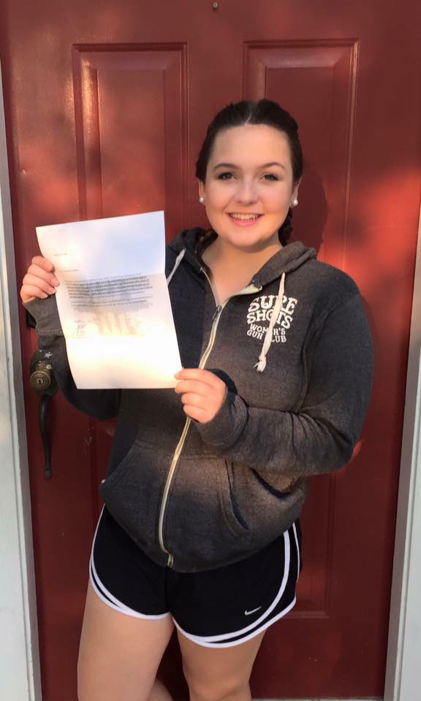
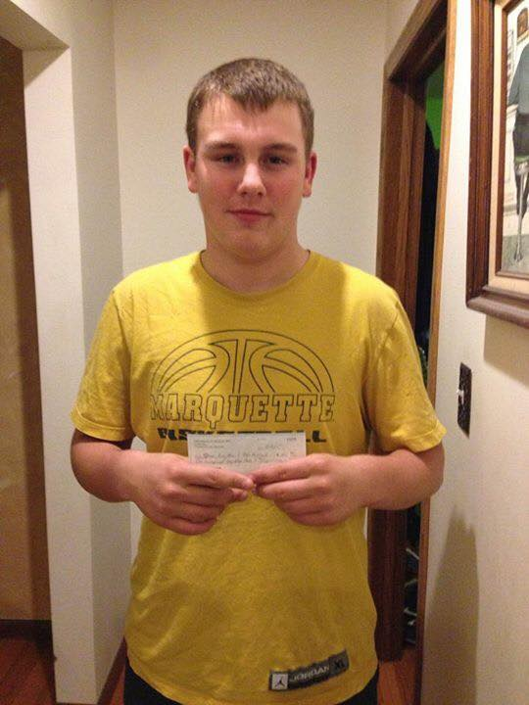
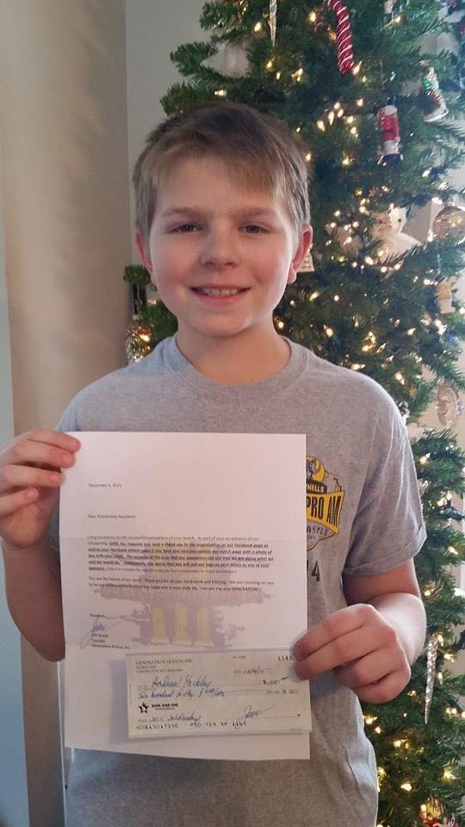
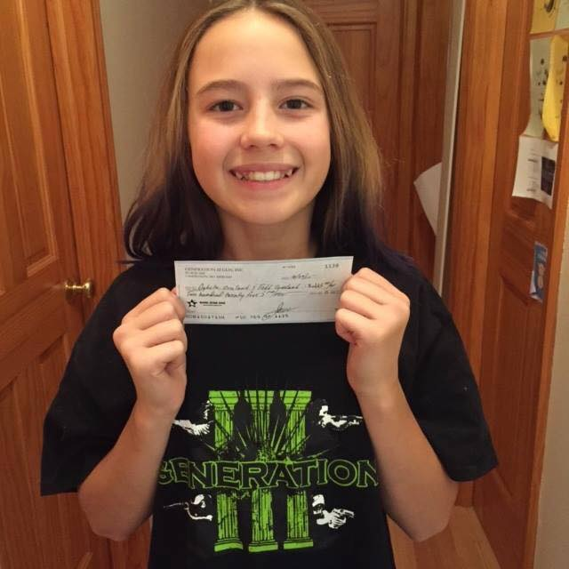
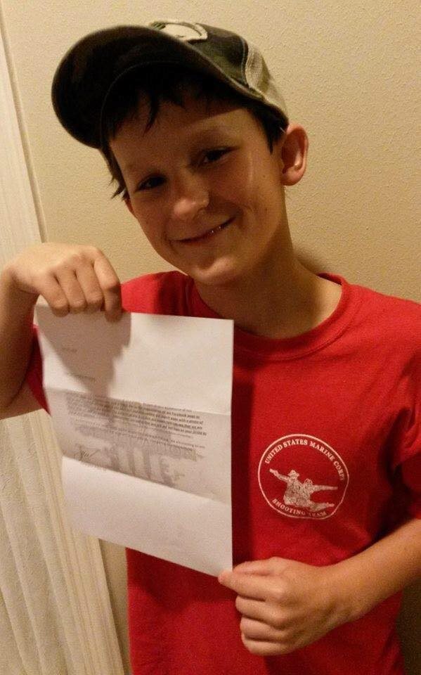
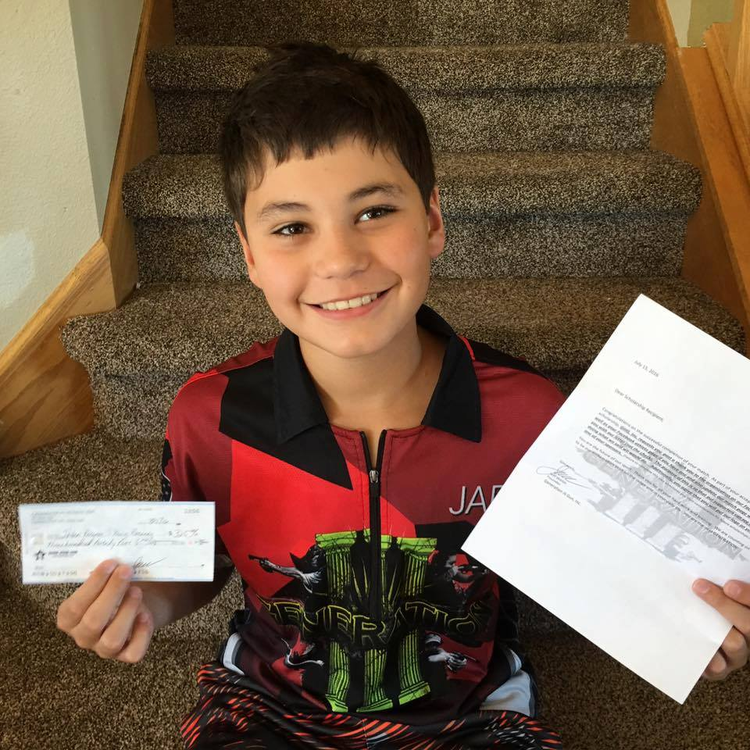
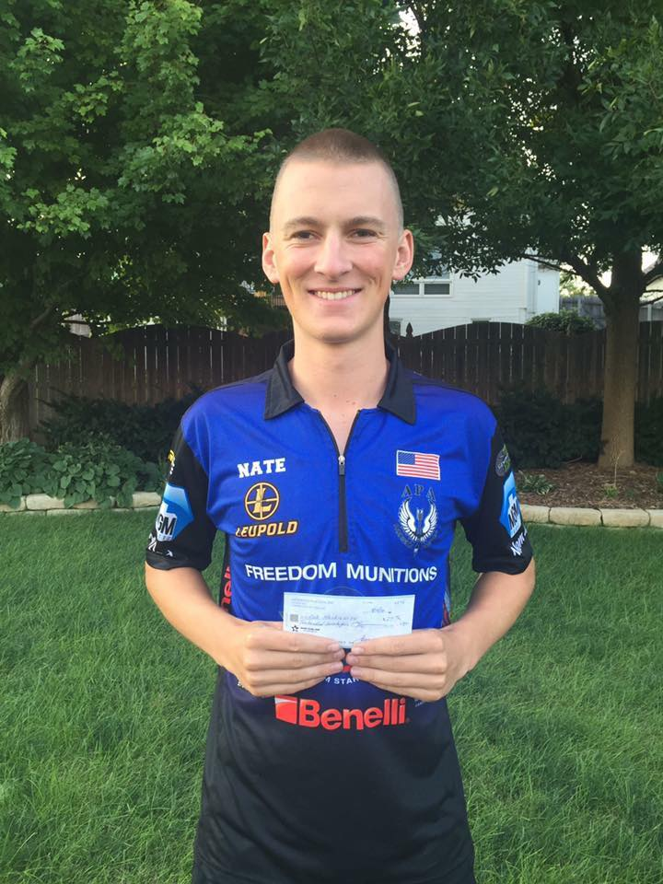
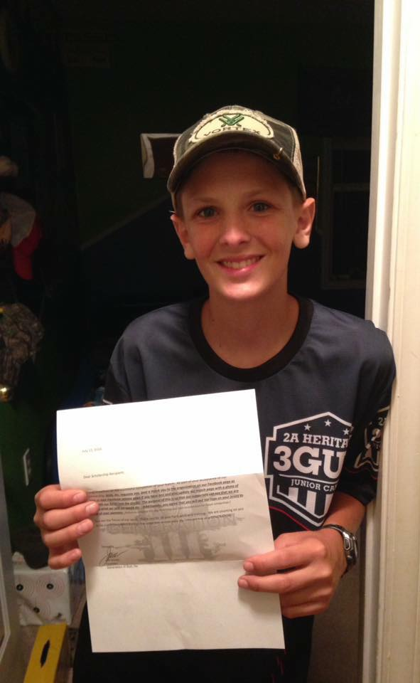
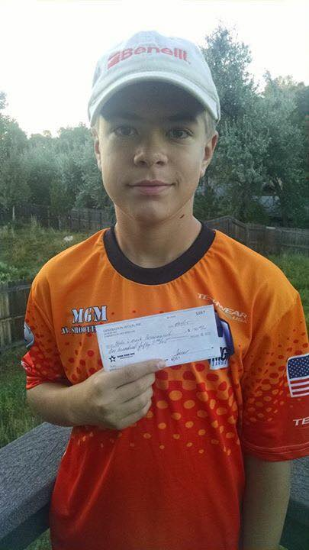
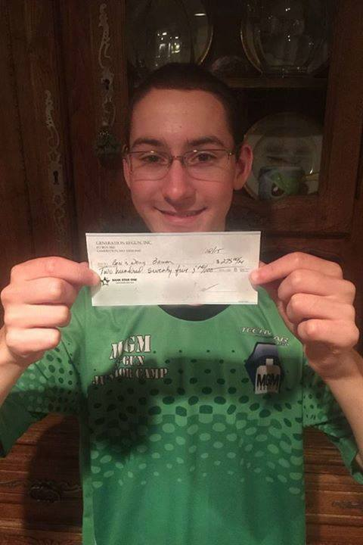
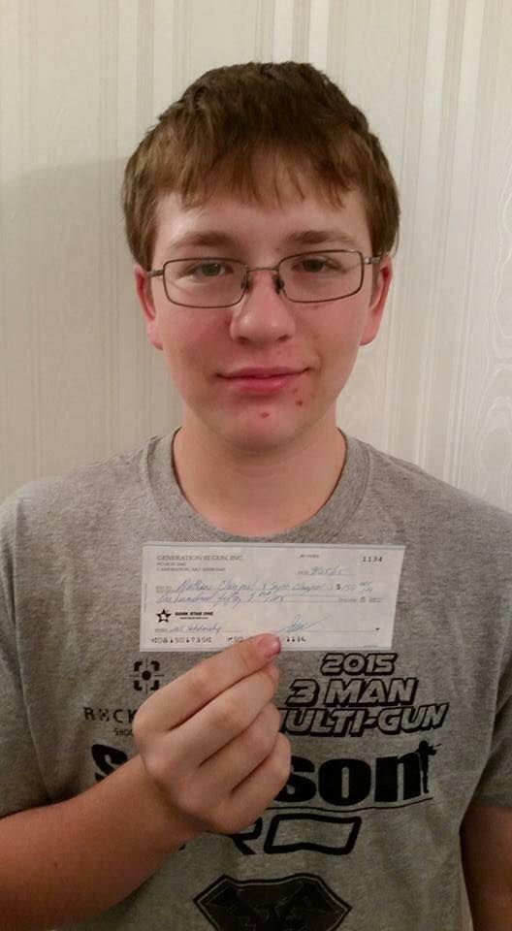
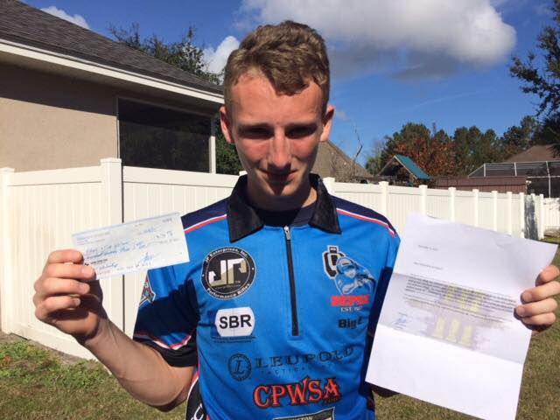
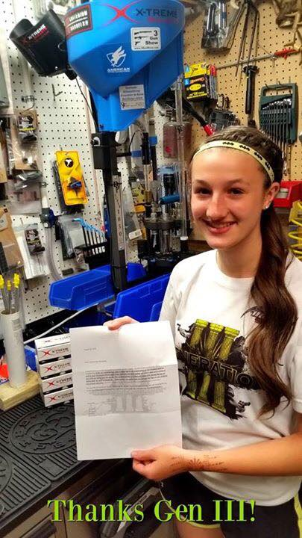
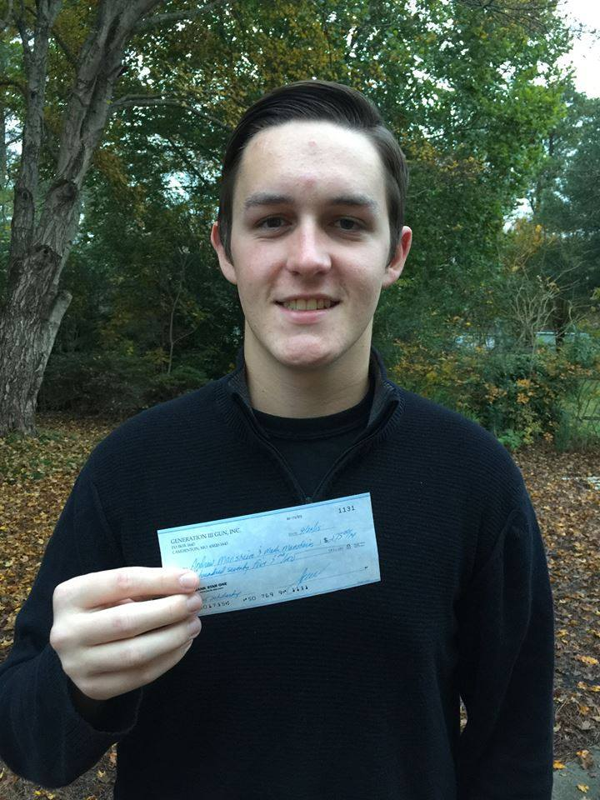
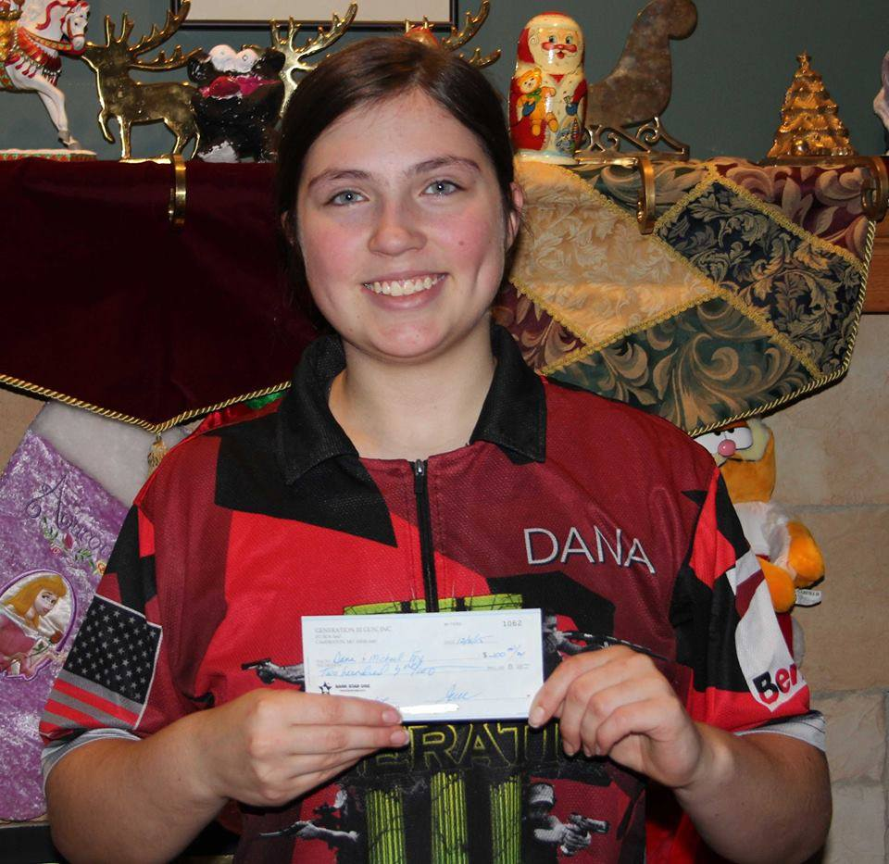
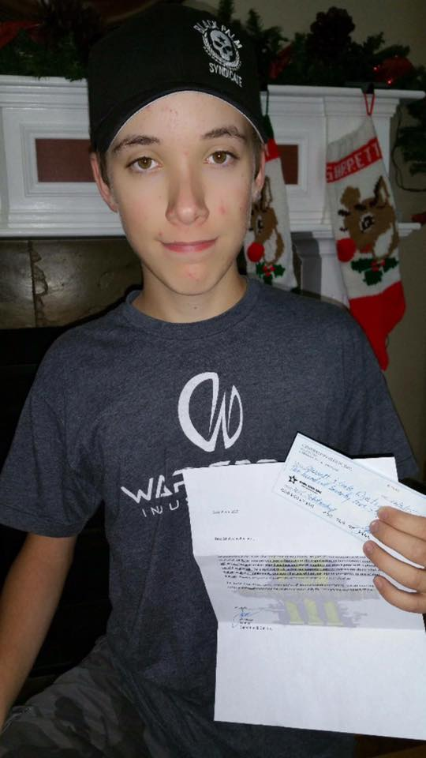
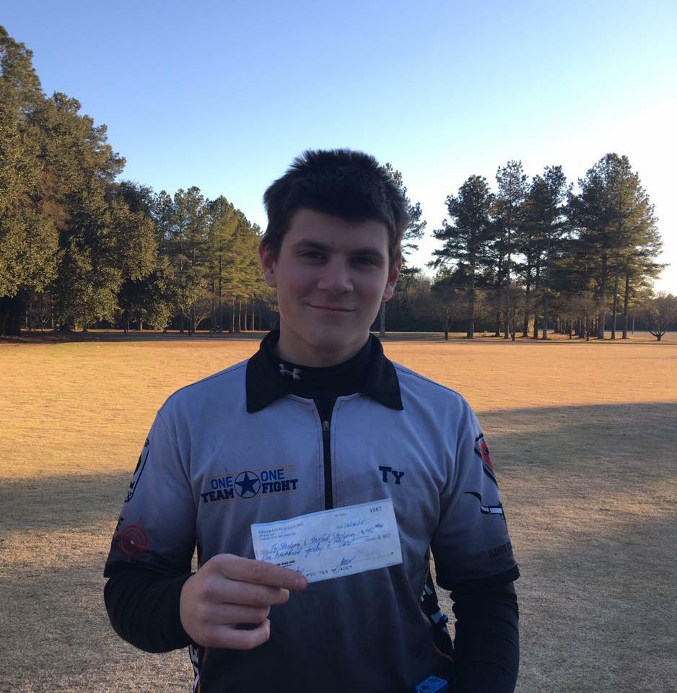
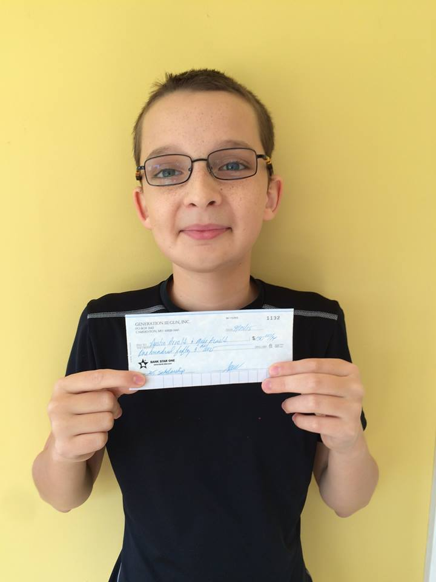
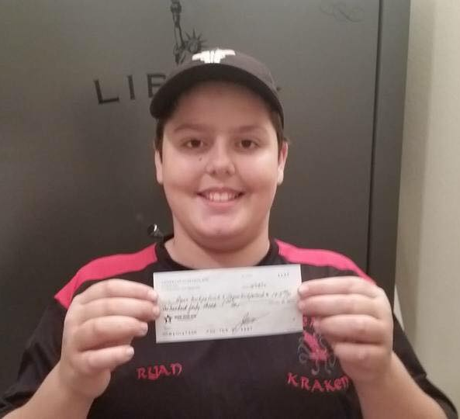
Generation III Gun Championship
Generation III Gun and all of these kids THANK YOU for your time and consideration.

Slide 17
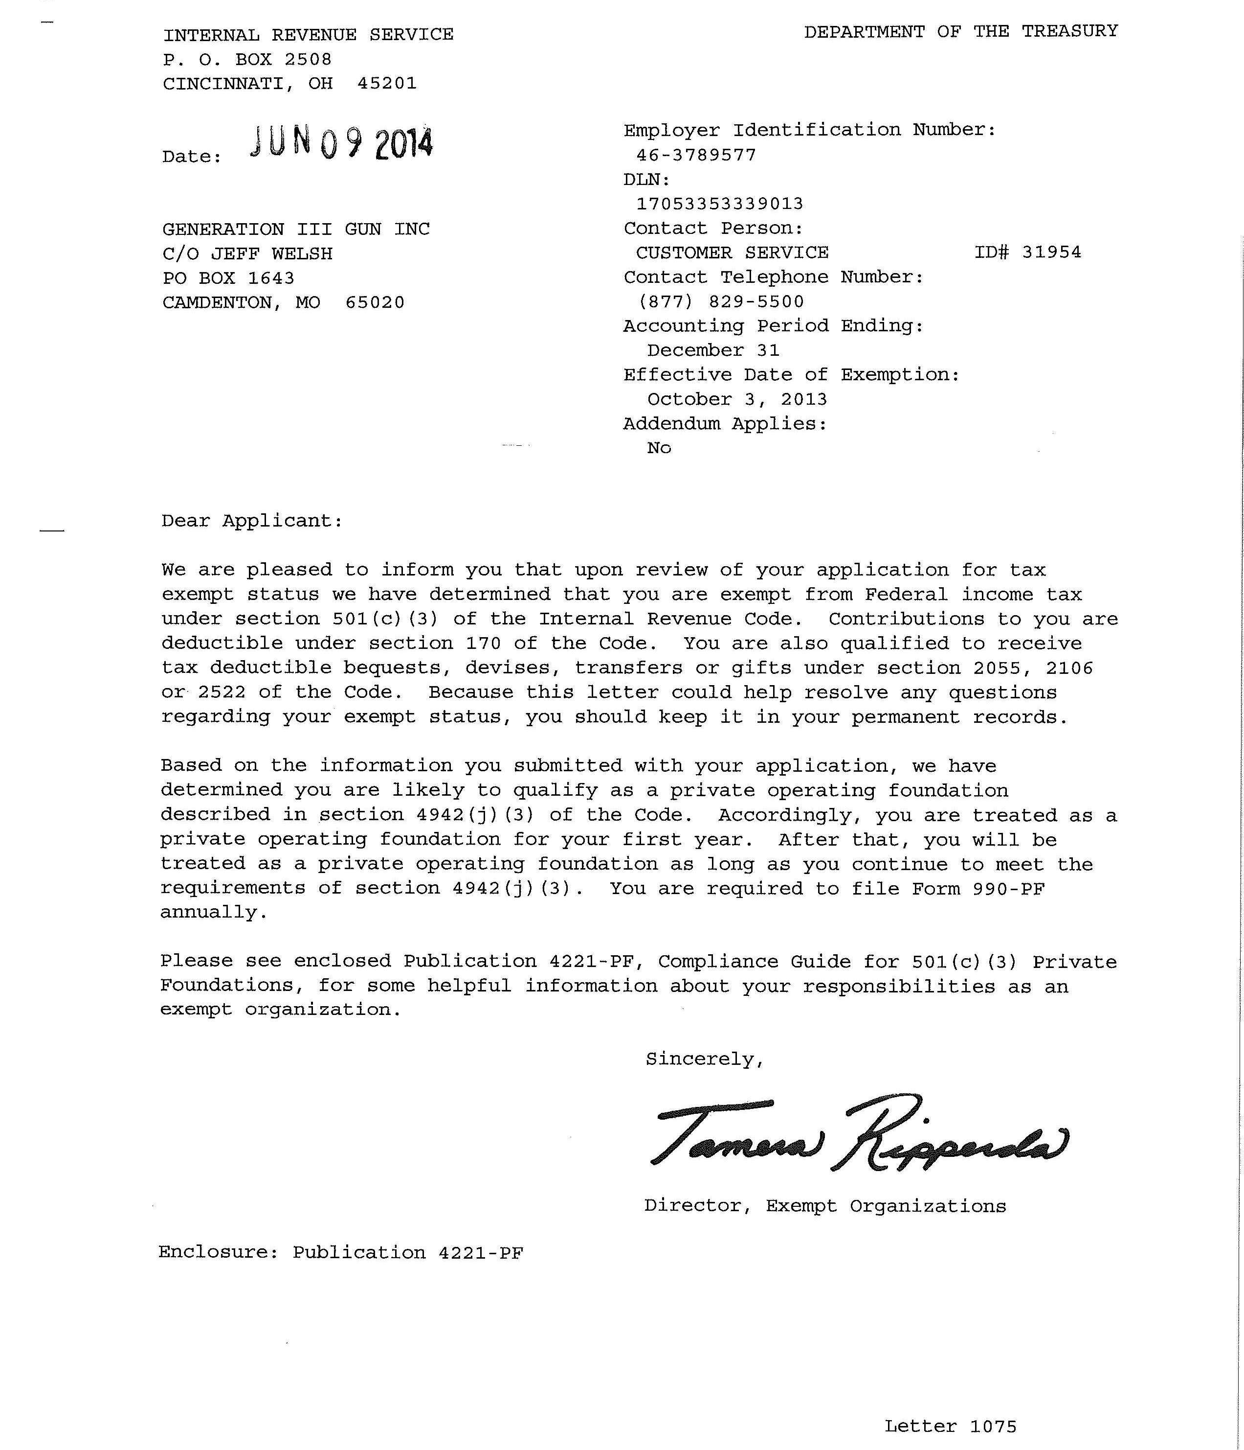
Generation III Gun Championship

